Slide 1
Green Propellant Thrust Stand
Team 517
Jeffrey Hill, Aidan Hoolihan, Ryan Kaczmarczyk,
Nicholas Jensen, Edward Zapert
11/19/2024

Slide 2
Team Sponsors & Advisors
Edward Zapert
Marshall Space Flight Center
Sponsors:
Advisors:
Ebony Bland
Aerospace Engineer
Nicole Vaughn
Liquid Propulsion Engineer
Alexandre Berger, Ph.D.
Assistant Professor
Shayne McConomy, Ph.D.
Professor

Slide 3
Team Introductions
Edward Zapert
Jeffrey Hill
Thermal Fluids Engineer
Nicholas Jensen
Manufacturing Engineer
Edward Zapert
Design Engineer
Aidan Hoolihan
Materials Engineer
Presenter
Ryan Kaczmarczyk
Controls Engineer
Presenter
Presenter

Slide 4
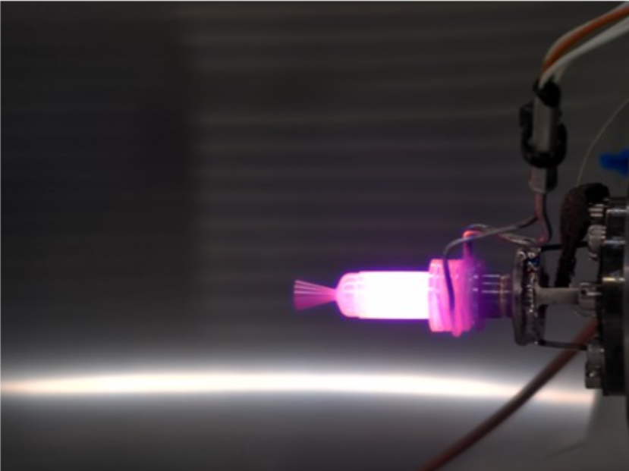
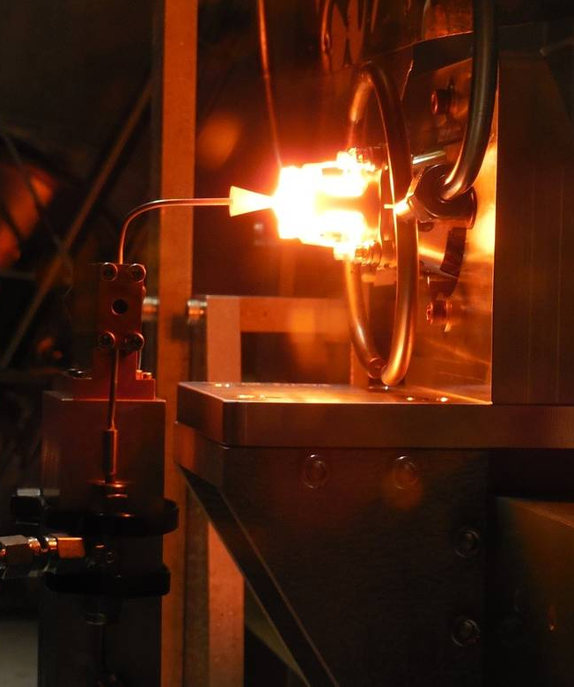
Objective
Edward Zapert
The objective of this project is to accurately measure the force generated by a 0.1N green propellant thruster with a known uncertainty.

Slide 5
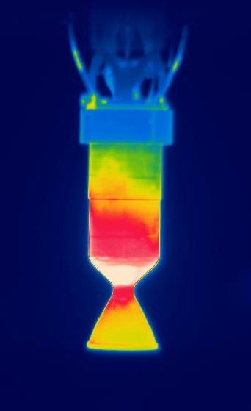
Project Brief
Edward Zapert
Green Propellant Thrust Stand
Accurately Measure 0.1N of Thrust
Create Thorough Documentation
Minimize Uncertainty

Slide 6
Project Background
Edward Zapert
Green Propellant
Safer to store and use than Hydrazine
Less expensive than Hydrazine
Requires less fuel onboard
ASCENT
(AF-M315E)
Developed by the Air Force Research Lab
Green propellant primarily used by MSFC

Slide 7
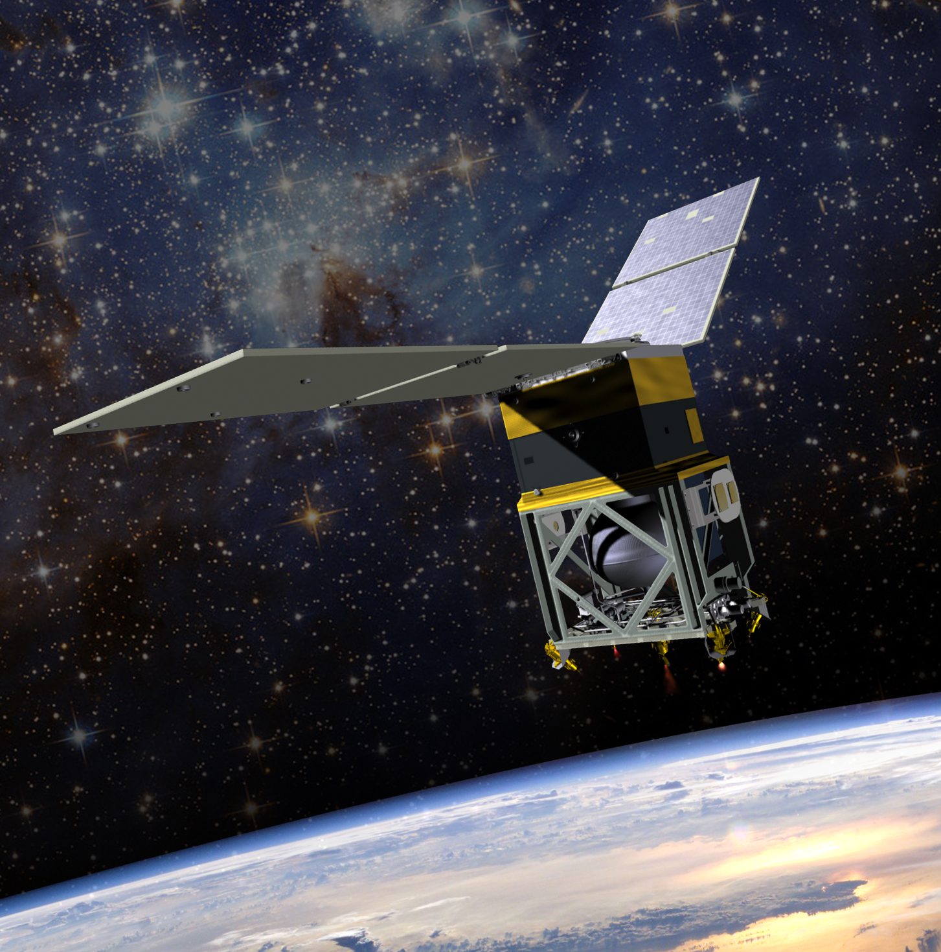
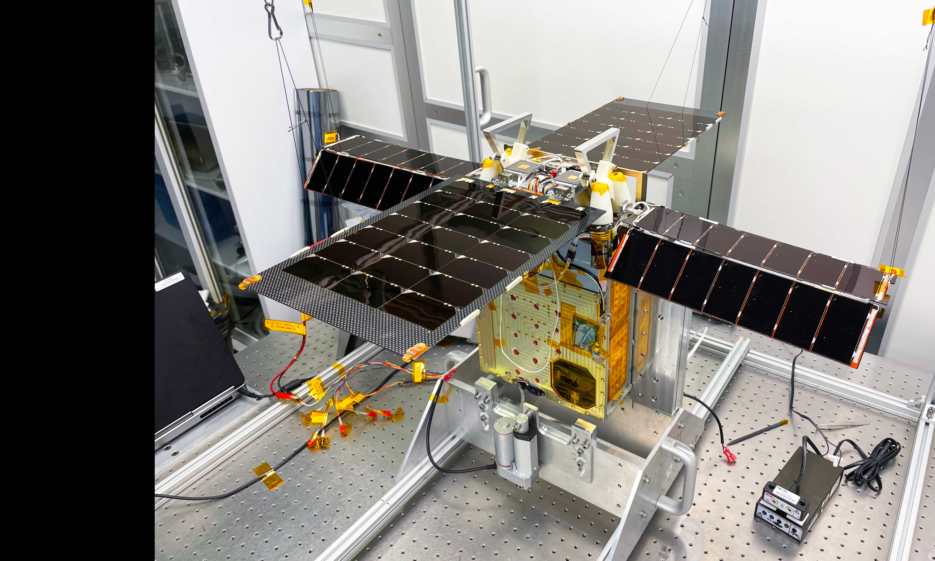
Project Background
Edward Zapert
GPIM
Tech demonstration mission
Altitude control, orbital inclination, orbital lowering
Lunar Flashlight
First planetary CubeSat mission with "green" propulsion
Map ice in permanently shadowed regions near the Moon's south pole.

Slide 8
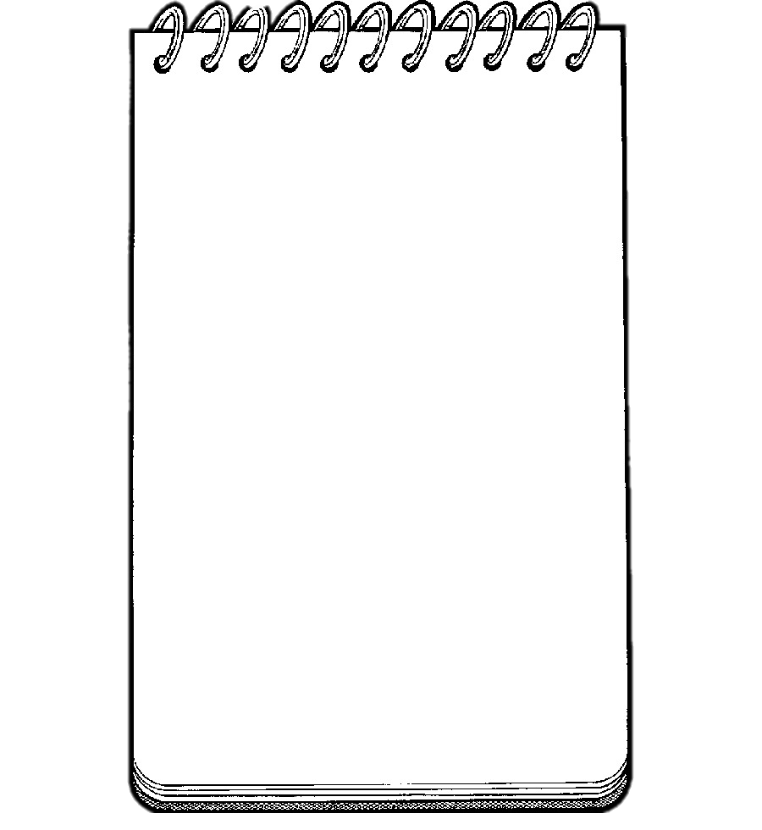
VDR 1 - Summary
Edward Zapert
Pinning down who has STAKE in our project, and what they require of our final design
Interpreted Needs:
- Thrust stand needs to withstand vacuum conditions
- Thrust stand should be able to be carried by one person
NASA-MSFC
Ebony Bland
Nicole Vaughn
Christopher Burnside
- The thrust stand needs to be easy to clean
- Provide accurate measurements
- Thrust stand can be no bigger than 12” x 18” x 12”
- The stand/sensor needs to endure temps up to 1600C
FAMU-FSU College of Engineering
- The stand/sensor needs to endure a pressure of 1e-6 Torr
Dr. McConomy
Dr. Berger
Elias Hasse
Tripp Lappalainen
Jacob Schmitt

Slide 9
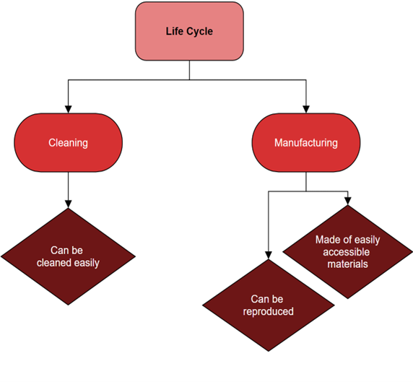
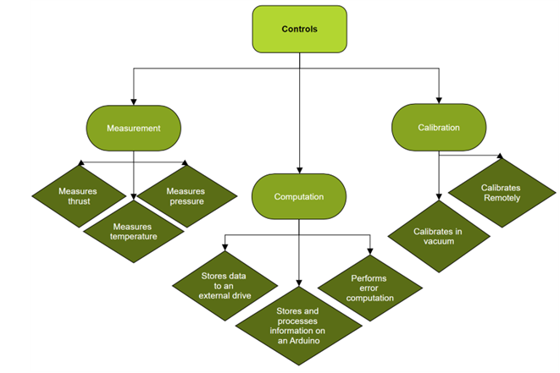
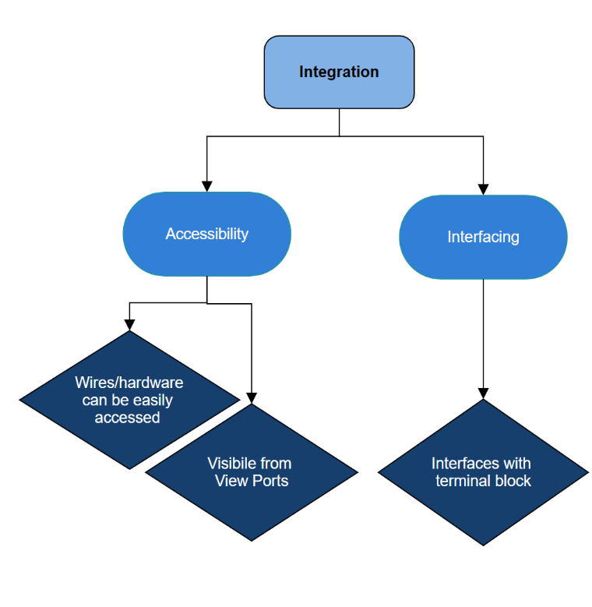
VDR 1 - Summary
Edward Zapert
Interpreting the needs into FUNCTIONS that lay the groundwork for our final design

Slide 10
Functionalities that Define Success
Edward Zapert
Critical Subsystems
Thrust Measurement
Calibration
Data Processing

Slide 11
Functionalities that Define Success
Edward Zapert
Thrust Sensor
Thrust Measurement Subsystem Target
Measure 0.1N of Thrust
0.1 N Thruster

Slide 12
Functionalities that Define Success
Edward Zapert
Calibration Subsystem Targets
Calibrates Remotely
Calibrates in a Vacuum
Vacuum Chamber Wall

Slide 13
Functionalities that Define Success
Edward Zapert
Calibration Subsystem Targets
Calibrates Remotely
Calibrates in a Vacuum
Thrust (N)
Calibration
Process
Time (s)
Zeros the Sensor
10g
98.1 mN
Vacuum Chamber Wall
Calibrates Using Known Weights

Slide 14
Functionalities that Define Success
Edward Zapert
Data Processing Subsystem Targets
Stores and Processes Information on a Microcontroller
∞
Δt
-
Thrust (N)
ARDUINO
+
Time (s)
Samples Data at 9260 Hz
Allocates RAM (16128 Bytes)

Slide 15
Functionalities that Define Success
Edward Zapert
Data Processing Subsystem Targets
Performs Error Computation
$$δT= \sqrt{{\left(\frac{\text{∂}\text{T}}{\text{∂}n_{1}}δn_{1}\right)}^{2}+ …+{\left(\frac{\text{∂}\text{T}}{\text{∂}n_{n}}δn_{n}\right)}^{2}}$$
∞
-
ARDUINO
+
Investigates Error Propagation
Calculates Error at 9260 Hz
Allocates RAM (16128 Bytes)

Slide 16
Functionalities that Define Success
Edward Zapert
Overall Thrust Stand Target
Provide an Overall
Analysis of System Error
$$\sum{F_{disturbance}}$$
Sensor Choice
Limit to 10% Error

Slide 17
Key Functions for Morphological Generation
Aidan Hoolihan
Accurately Measure Thrust
Made of Easily Accessible Materials
Easily Cleanable
Thruster Orientation
Vacuum Conditions
Remote Calibration
ASCENT
Accurately Measures Temperature
Calibrates in a Vacuum
Microcontroll-er Accounts for Error
Generic Stand Mechanics
NASA MSFC
FAMU-FSU COE

Slide 18
Aidan Hoolihan
Accurately Measure Thrust
Potential Solutions
Piezo-electric Sensor
Capacitive Force Sensor
Strain Gauge Load Cells
MEMS-Based Force Sensors
Flow Sensor

Slide 19
Aidan Hoolihan
Accurately Measures Temperature
Potential Solutions
Thermo-couple
Infrared Sensor
Thermistor
Fiber Optic Sensor
Vacuum Conditions
Remote Calibration
ASCENT

Slide 20
Aidan Hoolihan
Easily Accessible Materials
Potential Solutions
Aluminum
Stainless Steel
Composite
Ceramic
Plastic
Vacuum Conditions
Remote Calibration
ASCENT
NASA MSFC
FAMU-FSU COE

Slide 21
Aidan Hoolihan
Calibrates in a Vacuum
Potential Solutions
Wired Calibration
Wireless Calibration
Vacuum Conditions
Remote Calibration
ASCENT
NASA MSFC
FAMU-FSU COE

Slide 22
Aidan Hoolihan
Easily Cleanable
Potential Solutions
Smooth, Non-Porous Materials
Modular Design
Protective Coatings
Drainage Features
Vacuum Conditions
Remote Calibration
ASCENT
NASA MSFC
FAMU-FSU COE

Slide 23
Aidan Hoolihan
Microcontroller Accounts for Error
Potential Solutions
Error Correcting Software
Feedback Control Systems
Sensor Fusion
Data Validation
Checksum and Cyclic Redundancy Check
Vacuum Conditions
Remote Calibration
ASCENT
NASA MSFC
FAMU-FSU COE

Slide 24
Aidan Hoolihan
Thruster Orientation
Potential Solutions
Vertically Mounted
Horizontal Mounted
Vacuum Conditions
Remote Calibration
ASCENT
NASA MSFC
FAMU-FSU COE

Slide 25
Aidan Hoolihan
Generic Stand Mechanics
Potential Solutions
Horizontal
Vertical
Seesaw
Torsional
Beam Deflection
Vacuum Conditions
Remote Calibration
ASCENT
NASA MSFC
FAMU-FSU COE

Slide 26
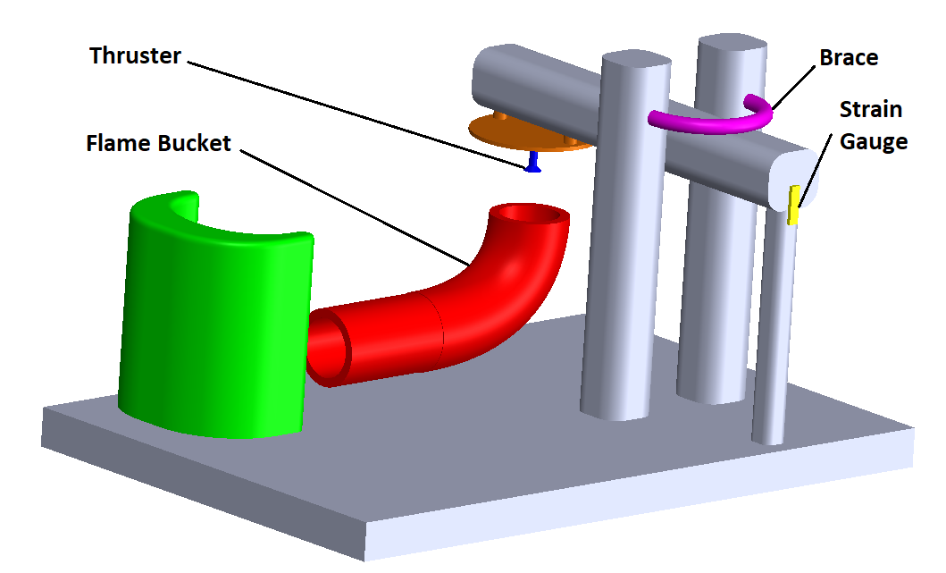
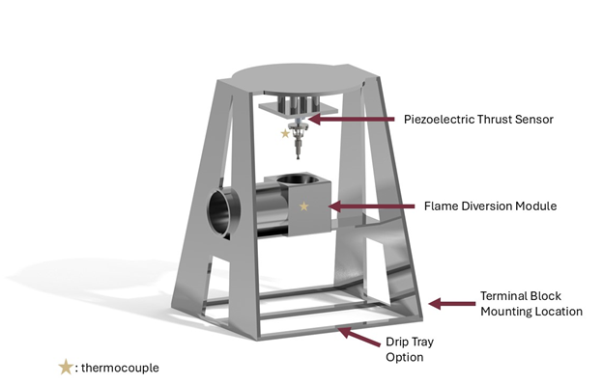
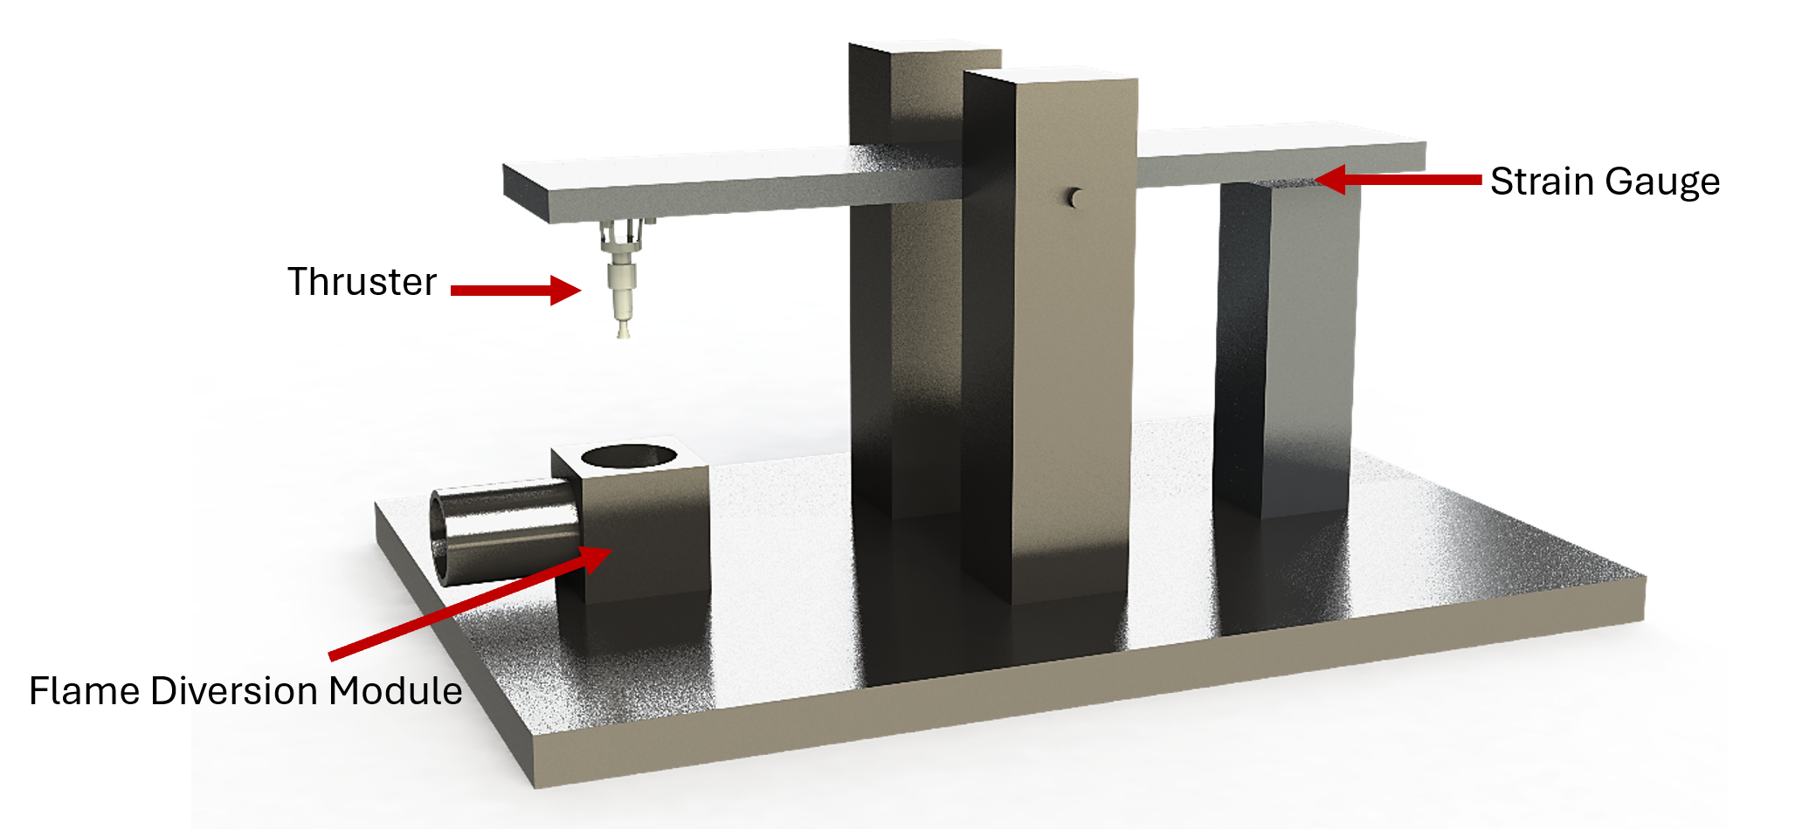
High Fidelity Selection
Nicholas Jensen
Concept 2
Concept 1
Concept 3

Slide 27
Concept #1
Nicholas Jensen
Material
Stainless Steel
Stand Type
Vertical
Force Measurement
Piezoelectric

Slide 28
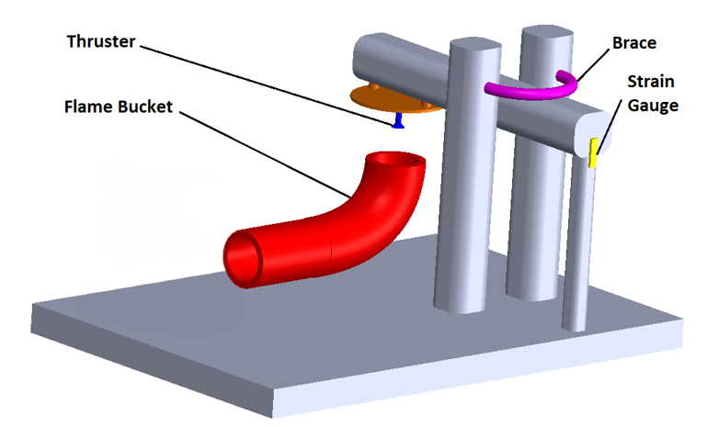
Concept #2
Nicholas Jensen
Material
Aluminum
Stand Type
Seesaw
Force Measurement
Strain Gauge

Slide 29
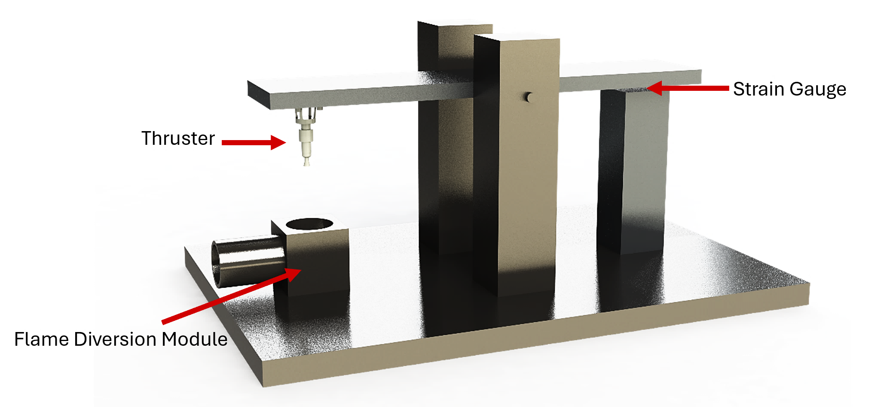
Concept #3
Nicholas Jensen
Material
Stainless Steel/Aluminum
Stand Type
Seesaw
Force Measurement
Strain Gauge

Slide 30
House of Quality
Nicholas Jensen
TOP 5
Engineering Characteristics
Sampling/ Processing Rate
Thrust Sensor Uncertainty
Maximum Thrust Allowed
1
RAM Allocation
2
Connections w/ Terminal Block
3
4
5
30

Slide 31
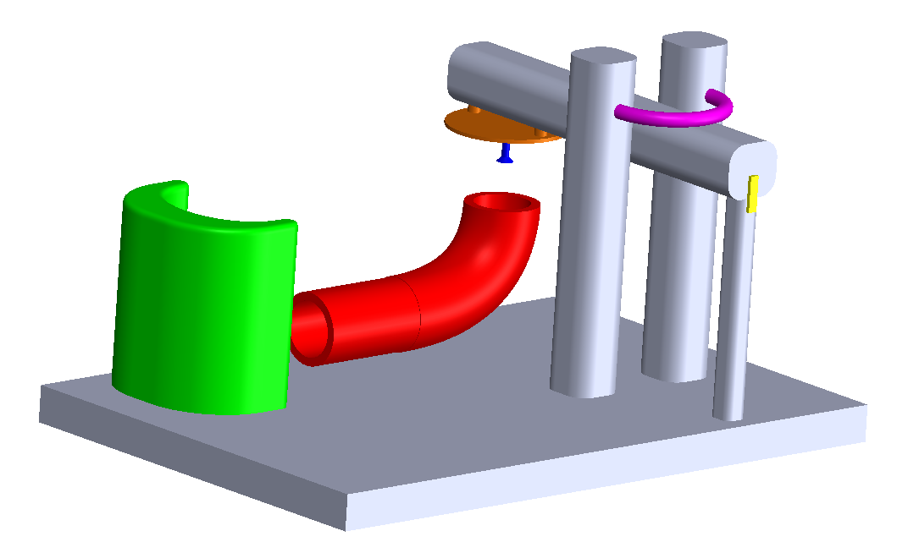
Pugh Chart #1
Nicholas Jensen
Concept #1
Concept #2
Concept #3
DATUM:
NASA-MSFC
Current Thrust Stand
Concept #4
​
​
​
​
​
​
​
Concept #5​
​
​
​
​
​
​
​
Concept #6
​
​
​
​
​
​
​
Concept #7
​
​
​
​
​
​
​
Concept #8
​
​
​
​
​
​
​
Piezo
Piezo
Strain
Capacitive
Strain
Stainless
Composite
Composite
Stainless
Stainless
Vertical
Vertical
Seesaw
Torsional
Horizontal
31

Slide 32
Nicholas Jensen
Pugh Chart #2
DATUM:
Concept #1
Concept #2
Concept #5
Concept #6
Piezo
Strain
Composite
Composite
Vertical
Seesaw

Slide 33
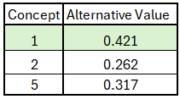
Final Selection
Nicholas Jensen
Calibration
Wired
Features
Modular Design
Drainage
Smooth Surfaces
Temperature Sensor
Thermocouple

Slide 34
Final Selection Evolution
Nicholas Jensen
Additions
Calibration Loading Mechanism
Modular Flame Diversion
Removable Tray
Modifications
Minimalistic Stand
Terminal Blocks
Vibrational Damping

Slide 35
Future Work
Aidan Hoolihan
NASA-MSFC Visit
Sensor Selection
Material Research
Spring Planning

Slide 36
Quick Recap
Aidan Hoolihan
Concept Generation
Key Functions
Concept Selection
House of Quality
Thrust Measurement
Core Functionality
Function Solutions
Calibration
Error Analysis
Pugh Chart
Final Selection & Evolution
Vacuum Conditions
Remote Calibration
ASCENT
NASA MSFC
FAMU-FSU COE

Slide 37
References
Aidan Hoolihan
https://www.rubicon.space/product/1/0-1n-ht-thruster
https://www.nasa.gov/missions/tech-demonstration/nasas-green-propellant-infusion-mission-nears-completion/
https://www.nasa.gov/missions/tech-demonstration/new-green-propellants-complete-milestones/
https://www.jpl.nasa.gov/missions/lunar-flashlight/
https://www.nasa.gov/missions/tech-demonstration/green-propellant-infusion-mission-gpim-overview/

Slide 38
Quick Recap
Aidan Hoolihan
Thrust
Temperature
Pressure
Accurate
Manufacturable
Remote Calibration
Scalable
Cleanable
Visibility
Green Propellant Thrust Stand
Vacuum Conditions
Remote Calibration
ASCENT
NASA MSFC
FAMU-FSU COE

Slide 39
Key Goals
Accurate
Manufacturable
Remote Calibration
Scalable
Cleanable
Visibility
Notes:
Accurately measure 0.1N of thrust
Manufacturability by a university
Perform a remote, in-place calibration in a vacuum environment

Slide 40
Back Up Slides

Slide 41
Slide Headline
Try to keep text at 16 pt minimum.
Try to put as few words as possible on the slide if you’re using for a presentation.
Mix and match the backgrounds as shown in this template or just use one throughout.
You can put department/unit logos in slide master at Horizontal 0.89” Vertical 6.44” From top left corner

Slide 42
Font Check
This is 10-point
This is 15–point Times
This is 20–point
This is 25–point
This is 30–point
This is 35–point
This is 40–point
This is 50–point
This is 60–point
This is 72–point
Notes:
Use at least 20-point font in Room A105, B134, and B136
Use at least 25-point font in Room B135

Slide 43
Assumptions
Vacuum Pressure (10⁻⁷ Torr < p < 10⁻⁴ Torr)
Green Propellant (ASCENT)
12in L X 18in W X 12in H Volume
Remote Initiation
Thruster Temperature (Up to 1600°C)
Notes:
Operate under a vacuum
Green propellant used
Thrust sensor force endurance forces similar to thrust
Labview?
Visible from view ports
Spatial constraint
Remote ability
Maybe add about temp up to 1600 C

Slide 44
College of Engineering Color Palette
1 2 3 4
Pantone: PMS 195 C
RGB: 120, 47, 64
Hex: #782F40
CMYK:19, 90, 50, 55
1 2 3 4
Pantone: Black C
RGB: 0, 0, 0
Hex: #000000
CMYK:0, 0, 0, 100
Garnet
Black
1 2 3 4
RGB: 238, 118, 36
Hex: #EE7624
CMYK:2, 66, 99, 0
1 2 3 4
Pantone: PMS 000C
RGB: 255, 255, 255
Hex: #FFFFFF
CMYK: 0, 0, 0, 0
Fang
Orange
White
Notes:
Avoid 75% Black in B135

Slide 45
Accent Color Palette
1 2 3 4
RGB: 0, 59, 111
Hex: #003B6F
CMYK:
1 2 3 4
RGB: 0, 59, 111
Hex: #003B6F
CMYK:
1 2 3 4
RGB: 251, 236, 93
Hex: #FBEC5D
CMYK:
1 2 3 4
RGB: 219, 215, 210
Hex: #DBD7D2
CMYK:
1 2 3 4
RGB: 251, 236, 93
Hex: #FBEC5D
CMYK:
1 2 3 4
RGB: 219, 215, 210
Hex: #DBD7D2
CMYK:
Tardis Blue
Tardis Blue
Corn
Timberwolf
Corn
Timberwolf
1 2 3 4
RGB: 206, 0, 88
Hex: #CE0058
CMYK: 0, 100, 43, 12
1 2 3 4
RGB: 206, 0, 88
Hex: #CE0058
CMYK: 0, 100, 43, 12
1 2 3 4
RGB: 104, 40, 96
Hex: #682860
CMYK:
1 2 3 4
RGB: 220, 220, 220
Hex: #DCDCDC
CMYK:
Rubine Red
Rubine Red
Imperial
Gainsboro
1 2 3 4
RGB: 72, 146, 155
Hex: #48929b
CMYK:
1 2 3 4
RGB: 64, 224, 208
Hex: #40E0D0
CMYK:
1 2 3 4
RGB: 255, 139, 0
Hex: #FF8B00
CMYK:
Asagi-iro
Turquoise
American Orange
Notes:
Remove American orange add hyperlink grey
Make corn the last for b135
All work in 134 imperial move later
Tardis doesn’t work in b136

Slide 46
F7AB19
D67F15
EE7624
D64615
F73119
Analogous
6E3610
F0A16C
EE7624
6E4931
BASB1C
Monochromatic
A14508
4BED3B
EE7624
250CED
2010A1
Triad
A1470C
FF8C40
EE7624
0098A1
24E2ED
Complementary
28A164
2FED8D
EE7624
0848A1
1871ED
Split Complementary
EDAC2F
3BED93
EE7624
0C6AED
ED2F18
Double Split Complementary
ED660C
C7ED3B
EE7624
0CE1ED
A418ED
Square
BA7E09
87724A
EE7624
60EFCF
09BA61
Compound
https://color.adobe.com/create/color-wheel
AD551A
6E3610
EE7624
FA7625
D46820
Shades
Notes:
These are the variants that work well with Fang Orange. The bolded items show well on the projectors.

Slide 47
85412D
8F3831
782f40
8F3176
792D85
Analogous
C44D69
8E626D
782F40
C48796
451B25
Monochromatic
C43959
78743B
782F40
236178
43A2C4
Triad
C43959
C46078
782F40
25C43D
2F783A
Complementary
93C460
577835
782F40
39C49D
297861
Split Complementary
784435
5A783B
782F40
237860
6E2978
Double Split Complementary
782337
78683b
782F40
237830
293978
Square
AB4D32
DEBAAF
782F40
5D8555
70AB32
Compound
https://color.adobe.com/create/color-wheel
38161E
C44D69
782F40
853447
5E2532
Shades

Slide 48
A105
A105
B135 Stage Left
B135 Stage Right
B136
B134, A105
B135

Slide 49
Border Line
Border Line
Border Line
Center of White Space
Center of Slide
Middle of Slide
Middle of White Space
Edge of Branding
Border Line
Notes:
Vertical lines from top down.
Borderline and top of title. (0.5 inch)
Center of Slide (0 inch y-direction for the entire slide)
Center of Design Content (0 inch y-direction considering the title, footer, and negative space)
Bottom of Design Content (0.25 in gap to the footer. 0.75 to the bottom of the screen)
Horizontal lines from left to right
Borderline (0.5 inch)
Center of design content.
Center of slide (0 inch y-direction for the entire slide)
Borderline (0.125 inch all around)

Slide 50
Markets
Jeffrey Hill
Primary Market
NASA-MSFC
Secondary Markets
Universities
CubeSAT Developers
US Military
Private Space Companies

Slide 56
Customer Needs
MEASUREMENT | STORAGE | INTERFACING
The plume temperature sensor accurately measures up to 1600 °C | Fits in a 12”L x 18”W x 12”H volume | Interfaces with an Arduino microcontroller and is compatible with LabVIEW
Able to record thrust exerted and pressure in relevant locations | Can withstand a maximum of 1e-6 vacuum pressure without outgassing | All sensors and wiring will terminate at the terminal block for ease of connection and portability
 | Designed to hold a 0.1N thruster and potentially scalable up to a 5N class thruster | Made of materials and parts that can be created with resources and shops that other universities will have access to

Slide 57
Orange/Garnet
Add name

Slide 58
Garnet/Orange
Add name
Vacuum Conditions
Remote Calibration
ASCENT
NASA MSFC
FAMU-FSU COE

